Slide 1
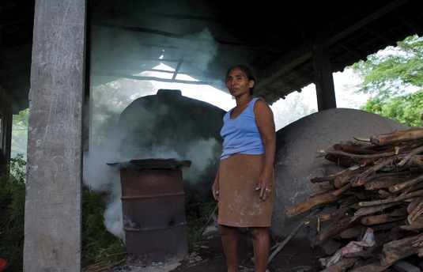
Gender Responsive National Communications and BURs
Photo credit United Nations
Toolkit for integrating gender analysis into national reporting

Slide 2
Purpose of the toolkit
Support countries to enhance NC and BUR reporting and meet UNFCCC guidance on gender
Improve gender responsiveness of climate change strategies resulting from NC and BUR recommendations
Meet international commitments to both climate change and gender equality
Notes:
UNFCCC guidance on gender refers to international best practices for gender analysis across sectors.
These include identification of gender issues, improved sex-disaggregated data collection, inclusion of both men and women in decision-making at all levels of climate change processes.
If gender issues are identified and addressed in stakeholder engagement, stocktaking and reporting on climate topics in the NC and BUR, then strategies for adaptation, mitigation, GHG reduction and technological needs assessment will be more informed and responsive to each country’s real needs and priorities
Integrating gender issues into UNFCCC reporting will concurrently support reporting on CEDAW and promotion of gender equality

Slide 3
Why is a Toolkit Needed?
To improve analysis of interactions between climate change and gender/social relations.
To clarify how these interactions impact effectiveness of climate change initiatives
To fill gaps in data, analysis and knowledge about women and men’s environmental roles
To build technical capacity of climate specialists – so they can do gender analysis
To build technical capacity of gender specialists – so they can analyze climate issues.
Notes:
Interactions include:
how men and women negotiate and divide responsibility for work,
how they use energy and natural resources,
whose interests take priority and
who benefits economically when environmental trade-offs are made.
If men and women are not equitably consulted and engaged in decisions about climate change:
programmes and projects may not be targeted to the right people,
Initiatives may not be sustainable and
actions may exacerbate existing gender inequalities
Few existing NCs and BURs include comprehensive sex-disagregated data in the national circumstances, adaptation and mitigation sections.
Without such data it is difficult to make fully informed recommendations about legislation, policy and programmes.
If climate change recommendations to government are not fully informed they can be less sustainable and more difficult to implement
Lessons learned from NCs and BURs to-date include the fact that there are gaps in technical capacity for gender-responsive climate change and environmental management

Slide 4
What Information Does the Toolkit Include?
Rationales to support advocacy
Explanations of how gender responsive NCs and BURs benefit national interests and meet reporting commitments for CEDAW, CRC, UNFCCC and Rio Conventions
Analysis, examples and tools
Country examples, steps for action, information on data and M&E
Gender issues by climate change topic
Gender analysis of vulnerability and adaptation, mitigation, GHG, MRV and technology needs
What is being done already, where are the gaps, what are the lessons?
‘How to do it’ suggestions
Building commitment for gender responsive reporting, budgeting for associated costs, building technical capacity for gender analysis and identifying indicators

Slide 5
Section One: Making the Case
First section of the toolkit presents rationales for integrating gender into NCs and BURs.
Identifies the value of investing resources in gender responsive climate change.
Identifies linkages between climate change and other development priorities including
human rights,
gender equality,
social inclusion and
poverty reduction
Notes:
Note to presenter: This is an overview of Section One – there is more related detail on the following slide.

Slide 6
Value Added of Gender in NCs & BURs
Transparency
Improved planning
Enhanced effectiveness
Efficiencies and Better results
Notes:
This slide’s information gives a general picture of the rationales in section one and the value added of gender responsive NCs and BURs. Note that dual mainstreaming refers to coordinated climate change and gender mainstreaming.

Slide 7
Section Two: Tools for Integrating Gender and Climate Change
Integrating gender in reporting processes
Stakeholder engagement, stocktakes, decision-making and coordination
Examination of country experiences, lessons learned and best practice
Gender issues by climate change topic
Gender analysis of vulnerability and adaptation, mitigation, GHG, MRV and technology needs
What is being done already, where are the gaps, what are the lessons?
Practical suggestions: ‘How to do it?’
Building commitment for gender responsive reporting, budgeting for associated costs, building technical capacity for gender analysis and identifying indicators
Notes:
This slide outlines the sub-components of Section Two

Slide 8
Conclusion: What Can the Toolkit Support?
More comprehensive stakeholder engagement
Improved stocktaking and analysis
Increased national discussion on linkages between development priorities – specifically gender and climate change
More accurate identification of gender indicators to support climate change monitoring and reporting
Notes:
In addition to it primary purpose of supporting gender responsive NCs and BURs, the toolkit can be used for advocacy, training, reference and to stimulate policy and funding discussions.

Slide 9
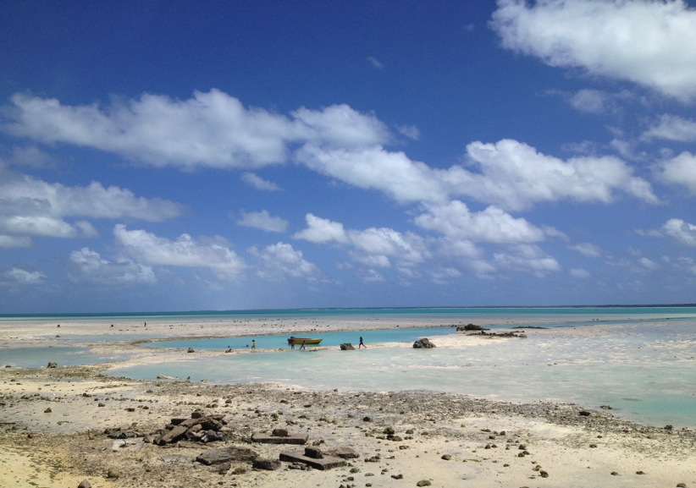
Thank you!
Produced by
UNDP’s Global Support Programme and
UNDP Gender Team
Photo credit Gayle Nelson
Notes:
Be prepared to answer or offer information about
Are copies available?
Are they in hard copy or electronic?
What should people do if they want a copy?
Can the toolkit be used as a training tool or is it a desk tool?
Is UNDP offering support to deliver training based on the toolkit?

